Slide 1
The Restoration Project
A 3rd person Action RPG

Slide 2
Presented By
Fahim Morshed
Kazi Muktadir Ahmed
BSSE 1102
BSSE 1111
Supervised By
Dr. Ahmedul Kabir
Assistant Professor
IIT, DU

Slide 3
Table of Content
1
Introduction
2
Scope of the Project
3
Motivation
4
Work Plan

Slide 4


01
Introduction

Slide 5
What we want to do in this Project
Build an Open World Role Playing Game
Freedom of movement and interaction
Engaging story with complex character arcs
Lots of side quests alongside the main quest line
Exploration focused gameplay

Slide 6
What we want to do in this Project (contd.)
Unique economic system where time is player health and the currency
Fully 3D animated objects and characters
Standard movement and vehicle mechanics
Third Person Shooting
Standard combat mechanics like shooting and melee combats
Stealth gameplay mechanics

Slide 7
02
Scope

Slide 8
Scope for this SPL
Limited Open World
Intro area
Standard gameplay mechanics
NPC and Enemy AI
A much smaller part of the Megalopolis
To showcase the game tutorial with all the core mechanics
Interactable NPC and challenging enemy AI
Character and Vehicle movement mechanics, Combat mechanics like shooting and melee combats

Slide 9
03
Motivation

Slide 10
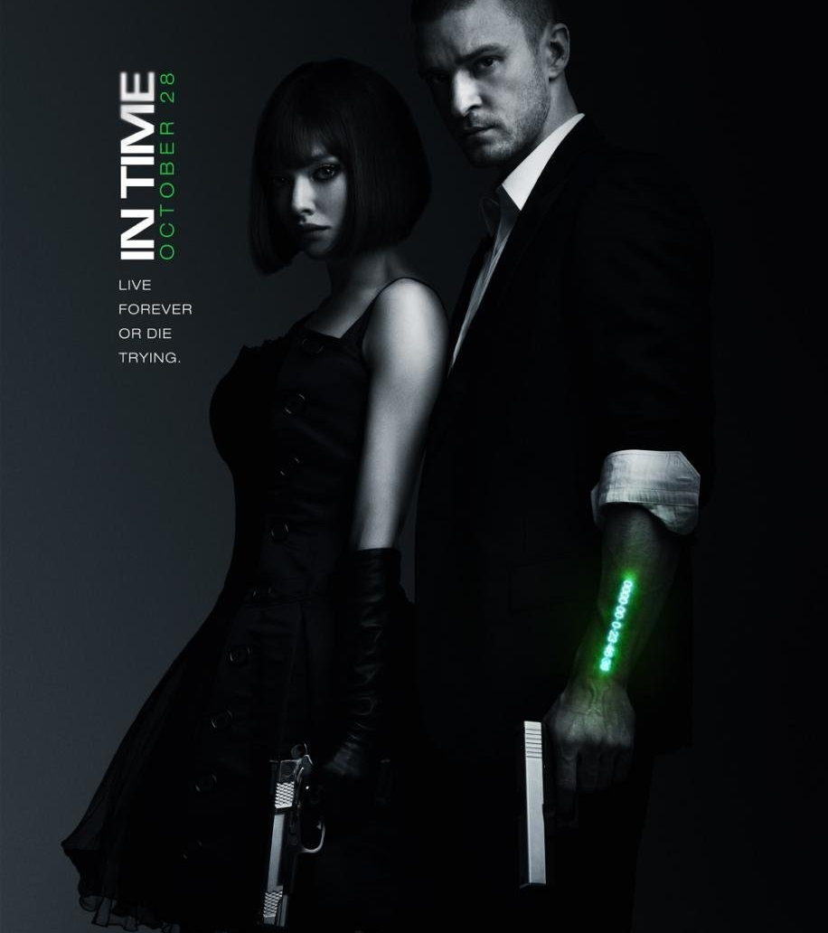
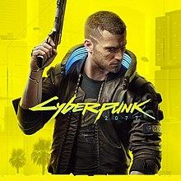
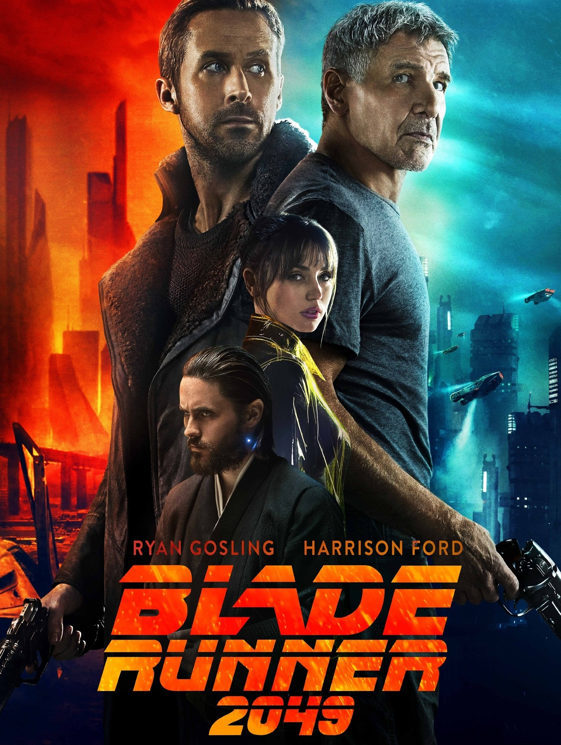
Inspiration behind the project
In Time (2011)
Cyberpunk 2077
Blade Runner
The Health and game economy was inspired from this movie
The gameplay mechanics was heavily inspired from this game.
This movie franchise inspired the world building and the overall aesthetic of our game heavily

Slide 11
04
Work Plan

Slide 12
Work Plan
Create a detailed map for a given area
Create assets for that section
Render these with Blender
Import assets into Unity
Write necessary scripts in C#
Repeat these process for the whole map

Slide 13



Technologies to be used
Blender
Unity
C#
To Create and render 3D assets for our game
Would be used as the game engine
Would be used as the scripting language

Slide 14
Thank You

